Slide 1

DIGITAL ANALYSIS
By
CHITRA PARSAILA
PRABHJOT SINGH
RITIK SHARMA
SAKTHI JANANI

Slide 2
Agenda
Business Context
Dashboard for CEO
Problem Statement
Dahboard for Website Manager
Data Availability
Data Model
Dashboard For Marketing Manager
Technology Stack
List of Data Check
Glossary
List of Analysis

Slide 3
Business Context
Overview:
The newly launched e-commerce retail start-up sells stuffed animal toys.
The company is planning to secure the next round of funding.
The CEO of the company needs to deliver a compelling business pitch to investors.
Objectives:
Create dashboards for different stakeholders to track business metrics and KPIs regularly.
Enable data-driven decision-making for stakeholders.
Provide detailed analysis of company performance and new product analysis.
Deliver a captivating business pitch by showcasing traffic analysis, website performance, progress of new products, and relevant insights and reports.

Slide 4
Problem Statement
Primary Challenge:
Creating comprehensive dashboards and detailed analysis to aid in securing funding and improving performance.
Specific Needs:
Company performance Analysis
Traffic Analysis & Website Performance
Products Insights
Reports for Investor Presentations

Slide 5

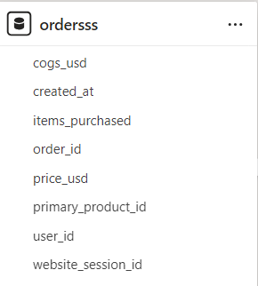
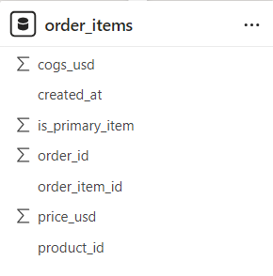
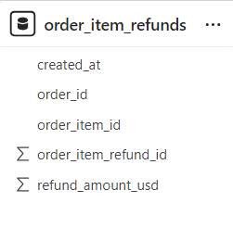


Data Availability

Slide 6
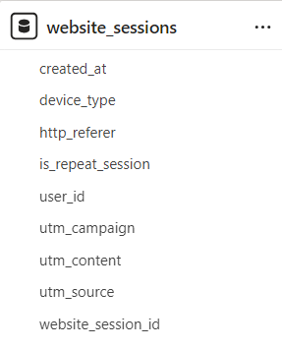
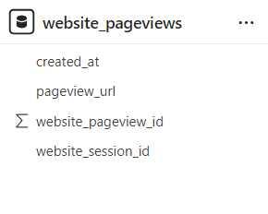
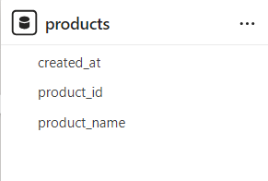
Data Availability

Slide 7
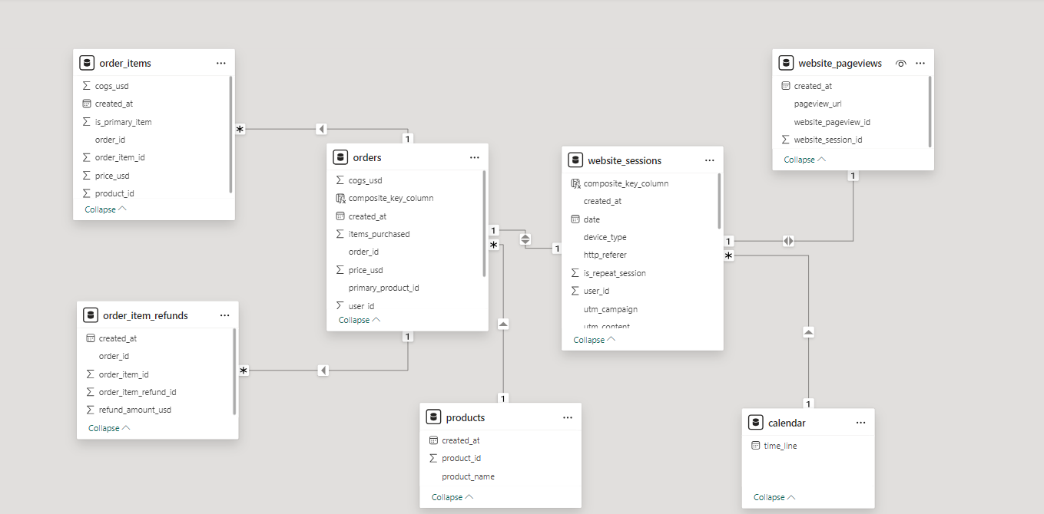
Data Model

Slide 8

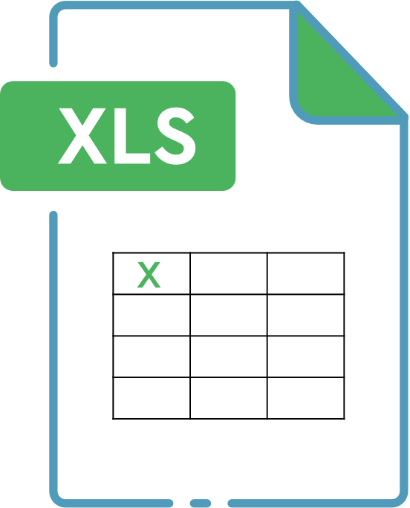

Technology Stack
The technology stack refers to the tools and platforms used for data extraction, transformation, loading (ETL), analysis, and visualization.
Excel: For initial data exploration and preliminary analysis.
SQL: For data extraction, transformation, and analysis.
PowerBI: For creating interactive dashboards and visualizations.

Slide 9
Detailed List of Data Checks
Integrity Checks:​
Ensured relationships between tables are maintained.​
Checked for duplicate rows
Consistency Checks:​
Data formats verified(e.g., dates, numeric values).​
Completeness Checks:​
Checked for missing values.​
Ensure all necessary columns are populated.
NULL valued handled
Accuracy Checks:​
Cross-checked totals and subtotals against source data.

Slide 10
List of analysis

Slide 11
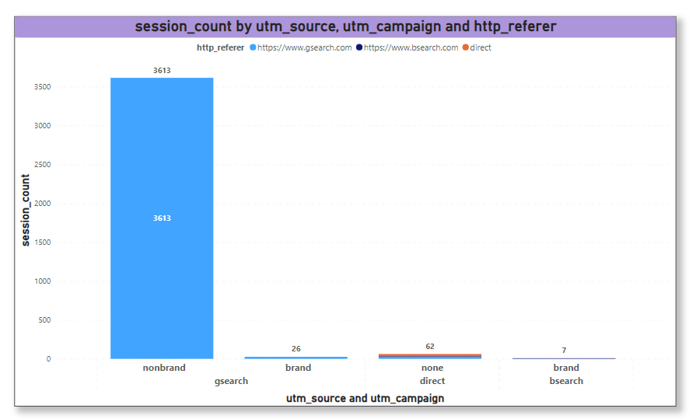
Traffic Breakdown
Insights
Gsearch is the dominant traffic source, indicating strong performance of non-branded Google search campaigns.
Recommendations
Given the success of non-branded Google search traffic, continue to invest in and optimize these campaigns.

Slide 12
Total Sessions | 3613
Total Orders | 107
CVR | 2.96%
Gsearch, Nonbrand Conversion Rate
Insight
This CVR is below the 4% threshold, indicating that the effectiveness of converting non-branded Google search traffic into orders is suboptimal.
Recommendations
Since the CVR is less than 4% threshold, we have to reduce the bid to optimize spending efficiency.
Redirect budget to higher-performing campaigns or other marketing initiatives.
Notes:
AOV - Average order value
total customer is the unique users of the website
refund rate = out of the total orders 5% of the order is returned

Slide 13
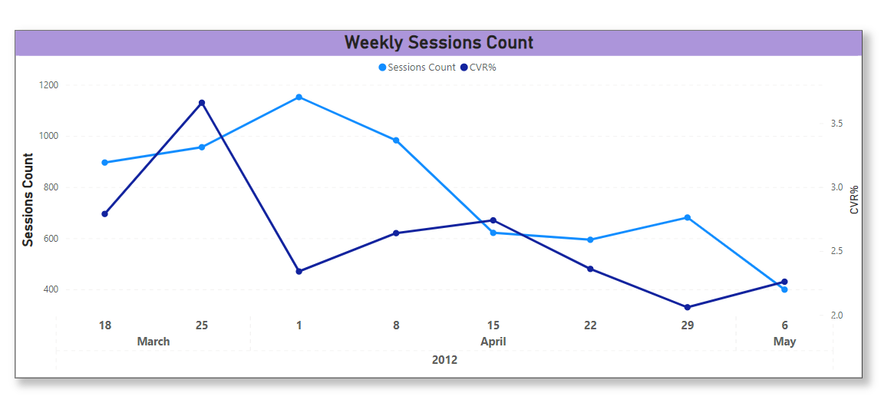
Traffic Source Trending
Insights
Sessions for Gsearch nonbrand campaign is impacted by bid change.
The session volume and CVR% after 2012-04-15 has dropped.
Recommendation
We want to maximize volume at the lowest possible bid

Slide 14
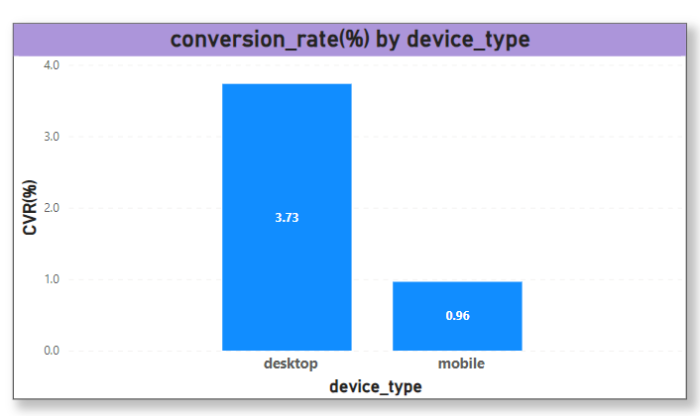
Traffic Conversion By Device Type
Insights
Desktop performance is better than mobile for gsearch, nonbrand campaign
Reccomendation
Desktop bids are driving nearly 4% of session to successful orders rate, so we should reduce mobile bids and transfer the paid traffic spent to desktop channel instead.

Slide 15
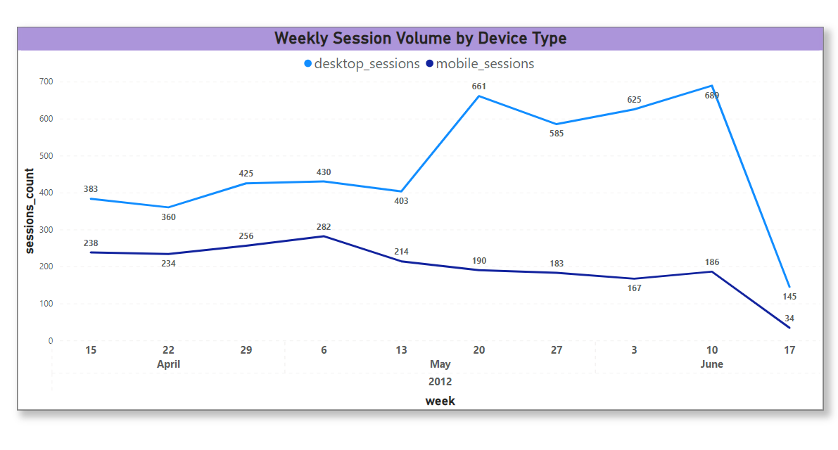
Traffic Source Segment Trending
Insights
After biding up desktop channel on 2012-05-19, desktop sessions saw a notable rise immediately after the bidding increase, indicating the strategy's effectiveness in driving more desktop traffic.
Conversely, mobile sessions did not benefit from the desktop bidding increase and even showed a slight decline.
Recommendation
Evaluate the cost-effectiveness and ROI of the increased desktop traffic to ensure that the additional spend translates into conversions and revenue

Slide 16
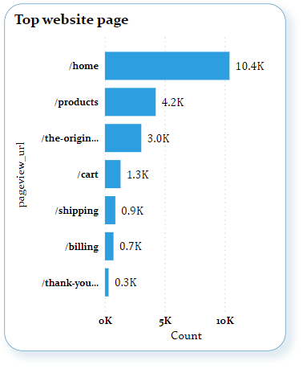
Top website page
Insights:
The home page had the highest visitor count for the period before June 9, 2012.
Recommendations:
Make sure the home page is engaging and easy to navigate to other pages.
More attention should be given to the product page to clearly list the products and make it easy to navigate through them.
Simplify the checkout process to reduce friction and improve conversion rates.

Slide 17
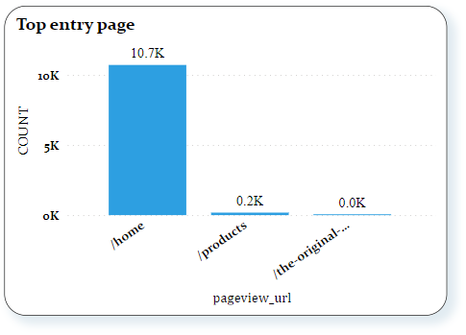
Top Entry page
Insights:
The home page had been the top entry page for the period before June 12, 2012.
The entry page is the first page viewed when a visitor enters a website.

Slide 18
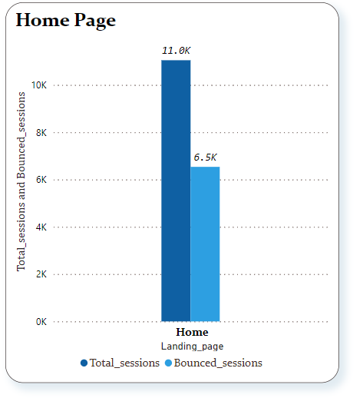
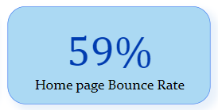
Bounce rate of Home page
Insights:
Here we have found the Bounce rate of the Home page before June-14-2012.
59% of the visitors leave the website after viewing only home page, this mean the home page is not more engaging for the visitors.
Recommendation's:
Here we have found the Bounce rate of the Home page before June-14-2012. 59% of the visitors leave the website after viewing only home page, this mean the home page is not more engaging for the visitors.

Slide 19
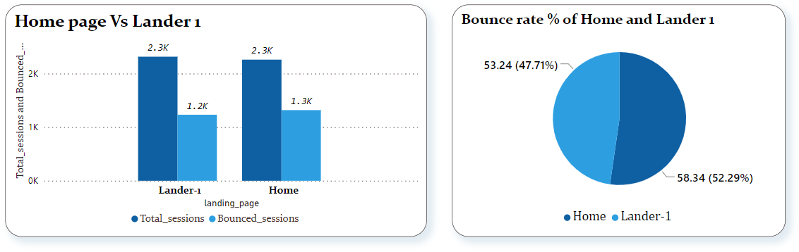
Analyzing Landing Page Tests
Insights:
Between June 19 and July 17, 2012, the bounce rate for the Lander 1 page was lower than that of the homepage.
The lower bounce rate for the Lander page suggests it is more engaging for visitors compared to the homepage.

Slide 20
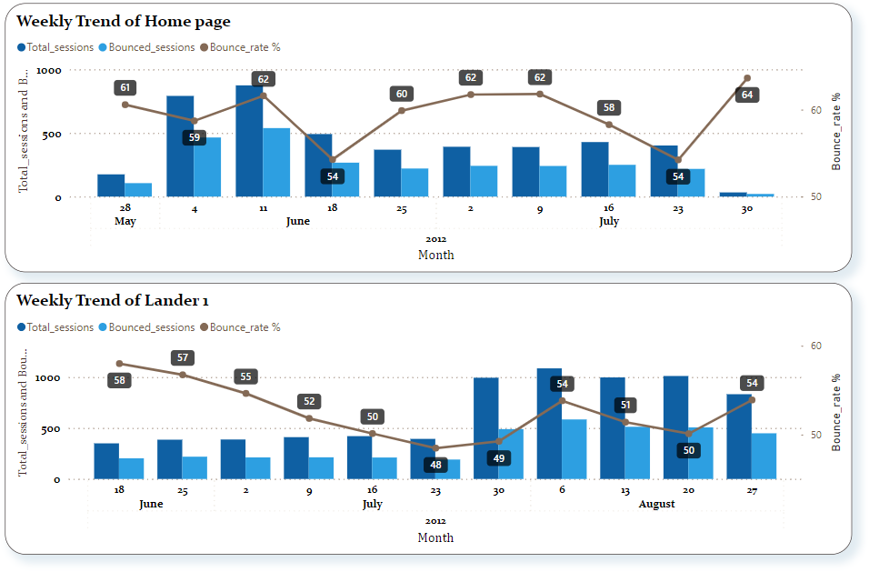
Landing Page Trend Analysis
Insights:
The landing page trend analysis was conducted from June 1 to August 31, 2012, for the GSearch non-brand campaign.
Before June 17, all traffic were routed to home, then after Aug 5 all traffic is routed to lander-1. Bounce rate dropped from 60%+ to nearing 50% so there is improvement. Changes made to /lander-1 page is working well.

Slide 21
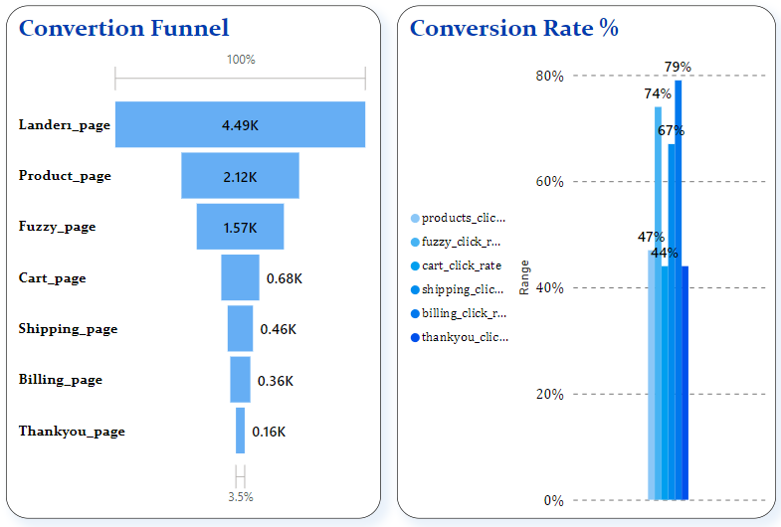
Conversion Funnel

Slide 22
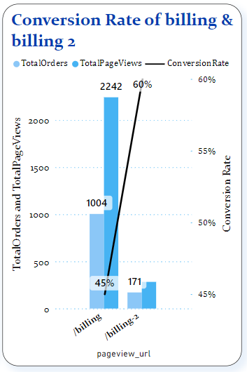
Conversion Funnel billing vs billing-2

Slide 23
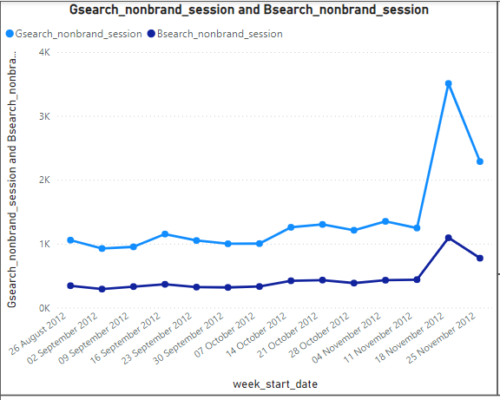
Channel Portfolios Analysis
Insight
Gsearch is the major source of traffic for non-brand campaign
Volume for both Gsearch & Bsearch channel peaks in November

Slide 24
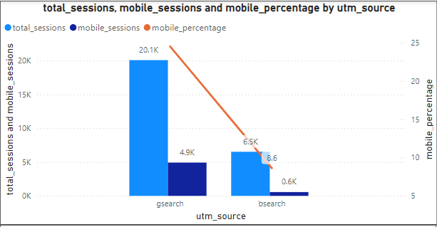
14
Channel Character Comparision
Insight
Traffic from Gsearch source with device type Mobile is approx. 25%
Traffic from Bsearch source with device type Mobile is 9 %

Slide 25
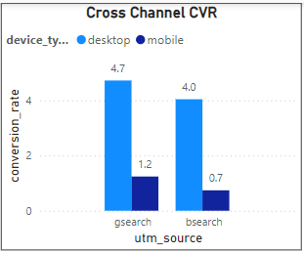
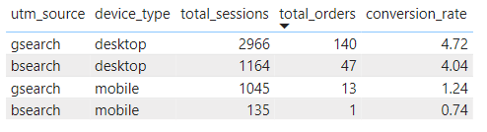
Cross-Channel Bid Optimization
Insight
Gsearch has higher conversion rates for both desktop 4.72 % and mobile 1.24 % compared to 4.04% and 0.7% for bsearch campaign
Recommendation
With relatively low conversion rate compared to Gsearch there is need to bid down on 'bsearch' campaigns.

Slide 26
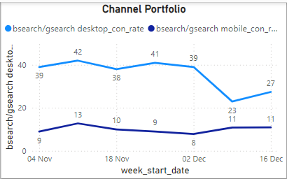
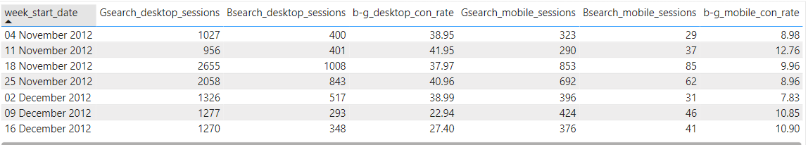
Channel Portfolio Trends
Insight
The desktop bsearch sessions was consistent at 40% of gsearch sessions, but dropped after reduced bids on 2 December

Slide 27
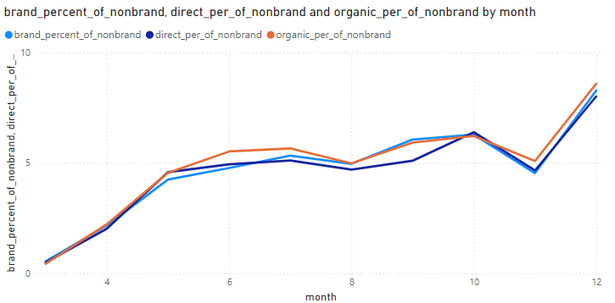
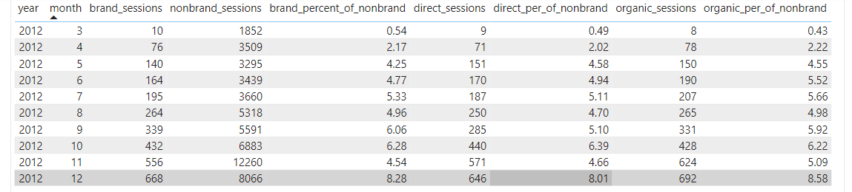
Analyzing Free Channels
Insight
Organic, direct and paid channels all are increasing over the time

Slide 28
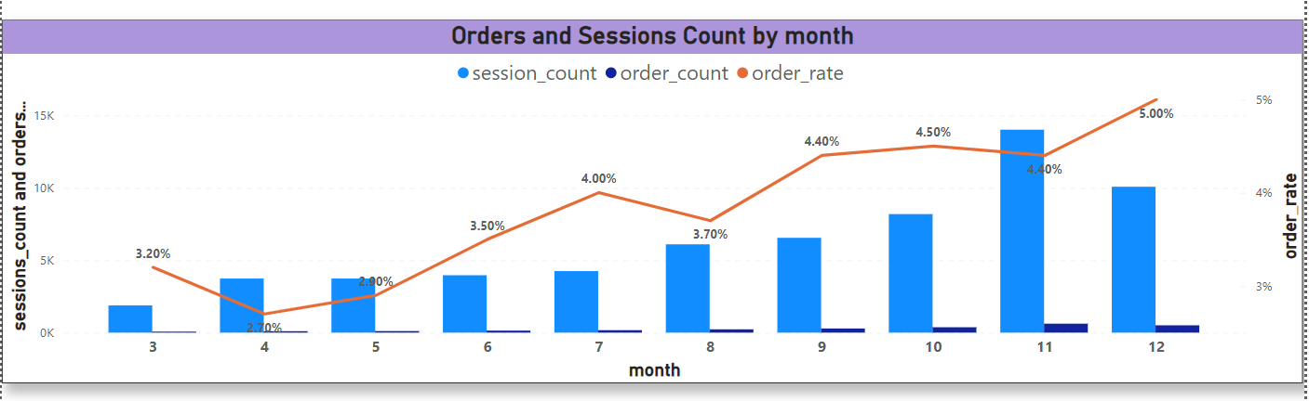
Seasonality Analysis(Monthly Trend)
Insights
There is a clear upward trend in both number of visitors and orders all year for 2012.
The highest session counts and order counts occur in around November, possibly indicating a strong holiday season impact.

Slide 29
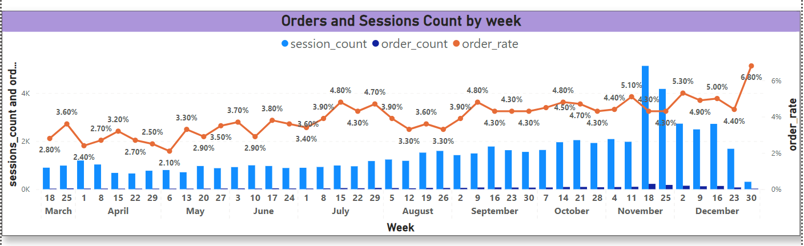
Seasonality Analysis(Weekly Trend)
Insights
There is a significant spike in sessions and orders during the week of November indicating a strong holiday season impact(Black Friday, Cyber Monday, etc)
A notable peak in order rate in the last week of December at 6.8%, likely due to Christmas sales.

Slide 30
Seasonality Analysis
Recommendations
Leverage Peak Periods: Focus on intensive marketing and promotional efforts during peak periods (October to December) holiday season to capitalize on high seasonal demand.
Resource Allocation: Allocate more resources, including staffing and inventory, during the high-traffic months (October to December) to ensure smooth operations and excellent customer service.
Conversion Rate Optimization: Improve the user experience on the website, such as offering personalized recommendations, simplifying the checkout process, and ensuring fast loading times to improve conversion rates during other months.

Slide 31
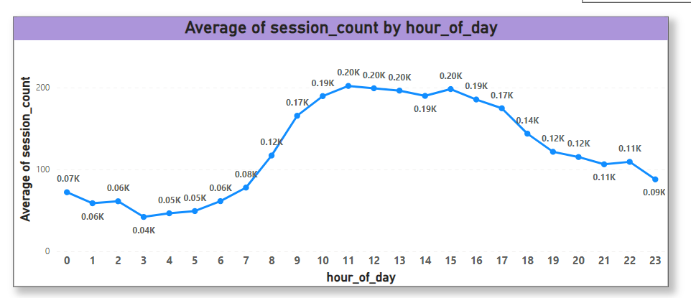
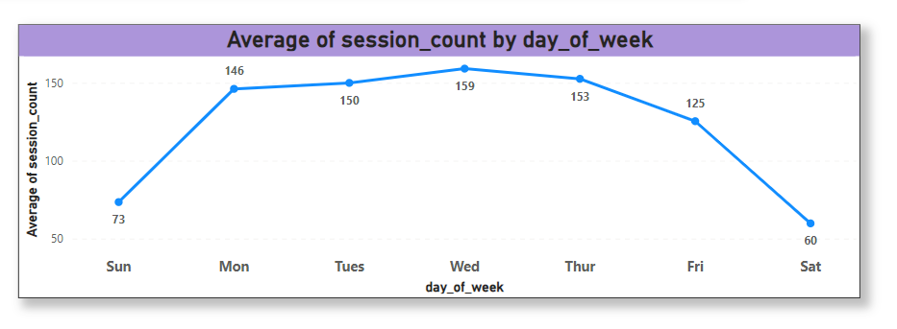
Business Patterns Analysis
Insights
Weekdays generally see higher session counts compared to weekends. Monday to Thursday have higher traffic than Friday to Sunday.
Within the day, session volume is significant especially between 8 AM and 5 PM . This indicates peak user activity during mid day within the day.

Slide 32
Business Patterns Analysis
Recommendations
Resource Allocation: Allocate resources (e.g. staffing levels and operational support) based on these peak times to ensure a smooth user experience and handle increased traffic efficiently.
Address Weekend Traffic: Evaluate the reasons for lower weekend traffic and explore strategies to drive more activity, such as exclusive weekend offers or content.

Slide 33
About Product
01/2013 :- 2nd Product (love bear) was launched, targeting couples for Valentine’s day.
12/12/2013 :- 3rd Product (birthday bear) was launched, targeting the birthday gift market.
02/05/2014 :- 4th Product (bear accessory) was launched as a cross-sell item.

Slide 34
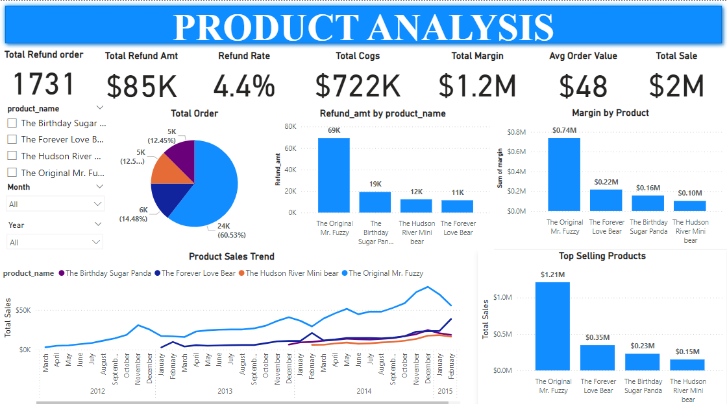

Slide 35
20
Product Level Sales Analysis
Continuous growth from March 2012, peaking in November 2014, followed by a decline.
Steady increase from March 2012 to January 2015, with a peak in November 2014 and a decline afterward.
Growth Period: Strong growth from mid-2013 to late 2014.
Seasonal Peaks: High sales and margins during November and December.
Post-Peak Decline: Drop in early 2015 suggests a post-holiday slump or market shifts.

Slide 36
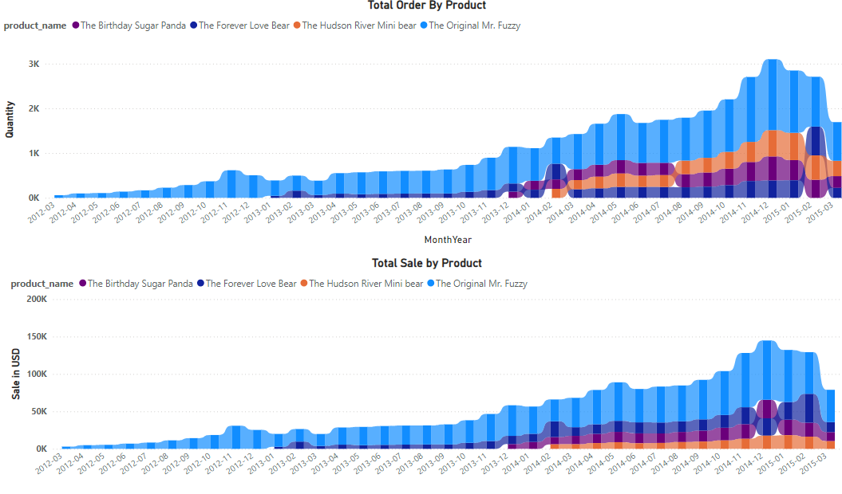
21
Product Launch Sales Analysis

Slide 37
Product Launch Sales Analysis
21
Steady increase in monthly orders, peaking in holiday seasons.
Conversion rates generally between 6.5% to 8.6%, with peaks in early 2015.
Revenue Trends:
Monthly revenue shows significant growth, especially during November and December.
Revenue per session improves steadily, reaching $5.43 by February 2015.
Product Performance:
The Original Mr. Fuzzy is the top seller, with increasing sales and revenue.
The Forever Love Bear also performs well.
Newer products like The Birthday Sugar Panda and The Hudson River Mini Bear show growing sales and contribute significantly to revenue.
New Product Impact:
Introduction of new products boosts overall sales and market segment capture.
Website Engagement:
Increasing website sessions correlate with higher order volumes and better revenue per session

Slide 38
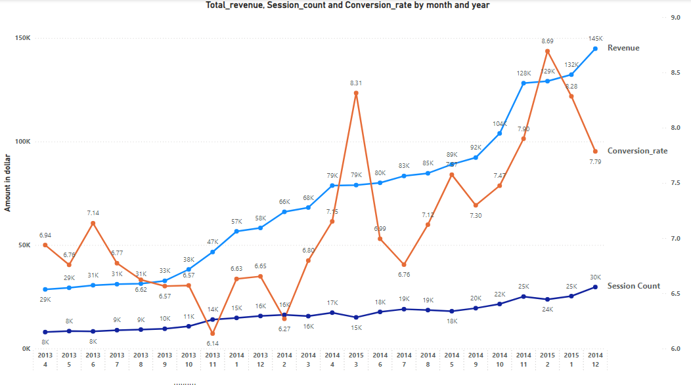
Product Launch Sales Analysis
21

Slide 39
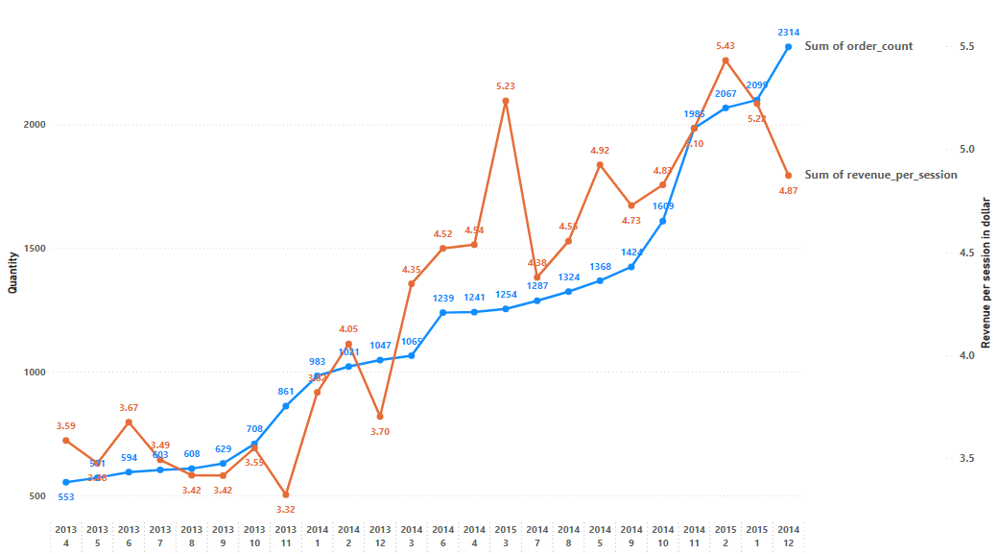
Product Launch Sales Analysis
21

Slide 40
Product Pathing Analysis
22
Since the launch of the Love Bear product, the percentage of clicks from the /products page to the Mr. Fuzzy product page has decreased.
However, the overall click-through rate for the /products page has increased.
This suggests that the Love Bear product is generating additional interest in products overall.
It is recommended that the conversion funnels for each product be investigated individually to better understand how the Love Bear product is impacting customer behavior.

Slide 41
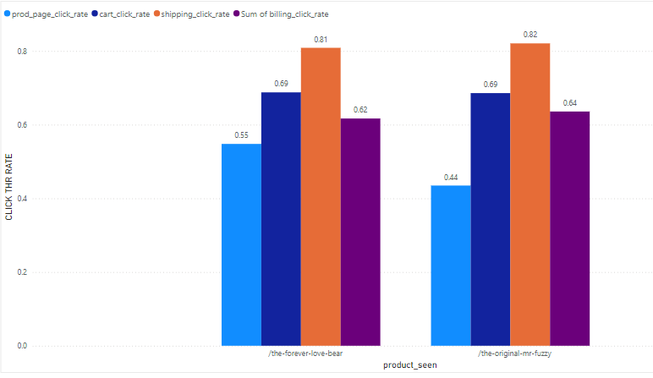
Product Conversion Funnels
Higher Engagement: Both products show increased engagement from product page to cart and shipping stages.
Opportunities for Improvement: Initial product page click rates are lower; focus on enhancing product page appeal to boost initial engagement.
Product Page Click Rate:
"The Forever Love Bear": 0.55
"The Original I’m Fuzzy": 0.44
Cart Click Rate:
Both products: 0.69
Shipping Click Rate:
"The Forever Love Bear": 0.81
"The Original I’m Fuzzy": 0.82
Billing Click Rate:
"The Forever Love Bear": 0.62
"The Original I’m Fuzzy": 0.64

Slide 42
23
Cross-Sell Analysis
Though It’s only been a short time, but the results so far are good.
The click-through rate (CTR) from the /cart page hasn’t gone down, like we were worried it might.
In fact, people are buying more products per order, and the average order value (AOV) and revenue per /cart session have all gone up a little bit.
While the cross sell feature does not appear to be a game changer at this early stage, the trend is positive.
I recommend that we continue to monitor the performance of the feature and make adjustments as needed.

Slide 43
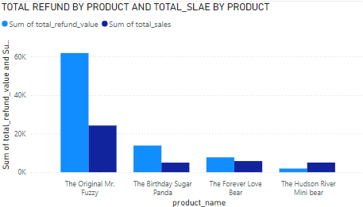
Product Refund Rate Analysis
"The Original Mr. Fuzzy" has the highest sales volume with 24,226 units sold, but it also has a relatively high refund rate at 5.11%. This could indicate that while the product is popular, there may be some quality or satisfaction issues.
"The Birthday Sugar Panda" has a lower sales volume (4,985 units) compared to "The Original Mr. Fuzzy," but it has the highest refund rate. This suggests a higher dissatisfaction rate among its buyers.

Slide 44
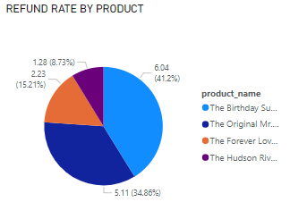
Product Refund Rate Analysis
"The Birthday Sugar Panda" having the highest refund rate at 6.04%, followed by "The Original Mr. Fuzzy" at 5.11%, "The Forever Love Bear" at 2.23%, and "The Hudson River Mini bear" at 1.28%.

Slide 45
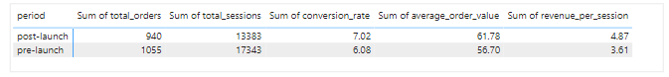
Portfolio Expansion Analysis
25
Decrease in Total Orders and Sessions:
There was a reduction in traffic and order volume post-launch.
Increase in Conversion Rate:
Conversion rate improved from 6.08% to 7.02%, indicating more effective visitor-to-customer conversion.
Increase in Average Order Value:
AOV rose from $56.70 to $61.78, suggesting higher spending per order.
Increase in Revenue per Session:
Revenue per session increased from $3.61 to $4.87, reflecting better revenue efficiency.

Slide 46
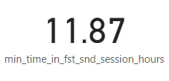
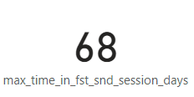
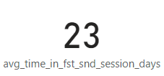
Analyzing Repeat Behaviour
Minimum time between first and second session for repeat user is 12 hours
Maximum time between first and second session for repeat user is 68 days
Average time between first and second session for repeat user is 23 days

Slide 47
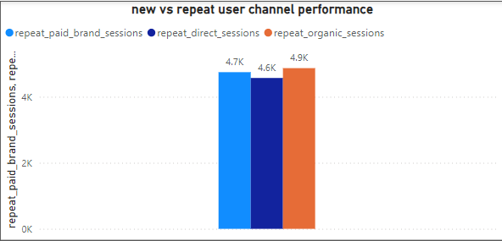
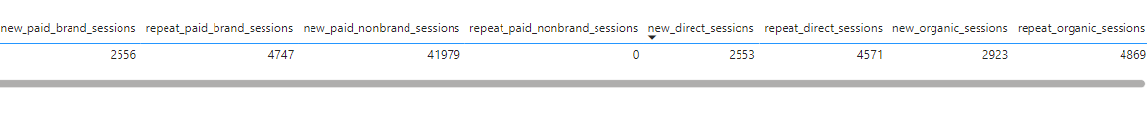
New Vs. Repeat Performance
Insight
Repeat users came mainly through organic, direct type-in and paid channels

Slide 48
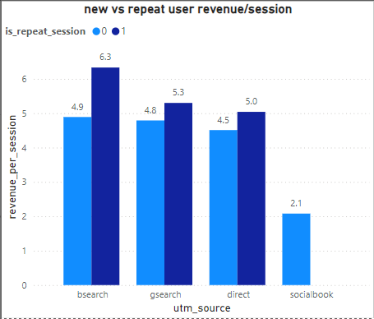
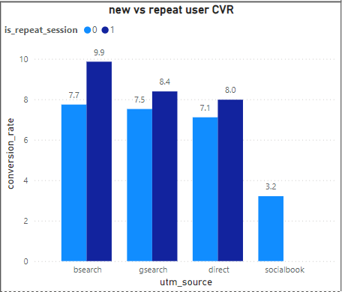
New s Repeat Channel Pattern
Repeat sessions generally have higher conversion rates and revenue per session across all sources.
Bsearch channel has the highest conversion rate 0f 10% for the repeat users.

Slide 49
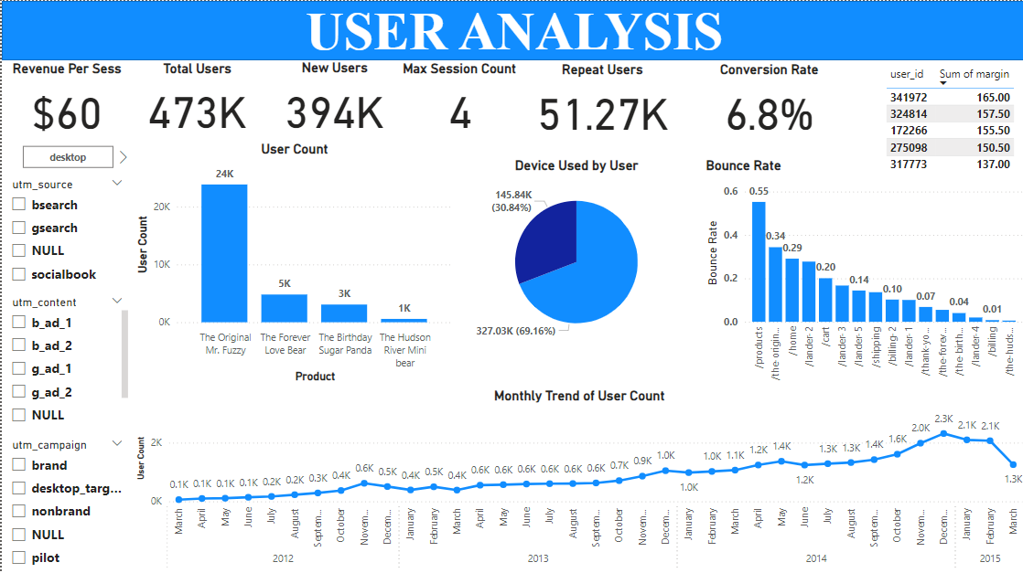

Slide 50
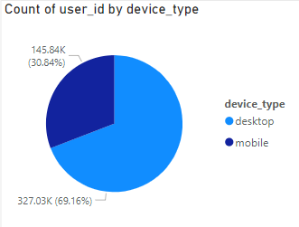
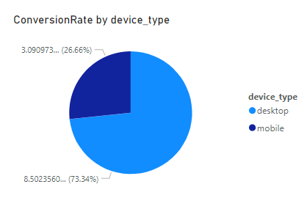
User Analysis
Desktop users have a significantly higher conversion rate compared to mobile users. This suggests that desktop users are more likely to complete conversions than mobile users.
A larger proportion of users access the service via desktop, but a significant number of users also access it via mobile.

Slide 51


User Analysis
The total refund amount is $85.34K, with "The Original Mr. Fuzzy" having 1382 returns. The "nonbrand" UTM campaign leads with 2.2M user IDs; "g_ad1" content is most effective.

Slide 52

User Analysis
The "gsearch" UTM source leads with 0.32M user IDs, indicating strong traffic from search engines. Other sources like "bsearch" and "socialbook" contribute fewer users, with "socialbook" being the least impactful source. This suggests search engine marketing is crucial for user acquisition.

Slide 53


Dashboard for CEO
Key performance indicator , Analyses and Dashboard

Slide 54


Slide 55


Slide 56
Website Manager
Dashboard

Slide 57

Unique Users | 394K
Page views | 1M
Avg Session Duration | 3 Min
Bounce rate | 45%
Conversion Rate | 7%
Avg Pages viewed per Session | 2 pages
Website KPI Summary

Slide 58


Slide 59


Slide 60


Slide 61
MarketingManager
Dashboard

Slide 62


Slide 63


Slide 64
Focus on High-Performing Channels
Since Gsearch is the top-performing channel, continue to invest in this source, optimizing campaigns to increase conversion rates further.
Enhance Mobile Experience
Although desktop is dominant, mobile still holds a substantial share. Optimizing the mobile experience can potentially increase conversions and sessions from this segment by introducing more intractive application.
Improve User Retention
With a notable number of repeat users, consider strategies to further engage these users. For instance, personalized marketing, loyalty programs, or retargeting campaigns could be effective.
Explore Underperforming Channels
Channels like Bsearch and socialbook are underperforming. Analyze these channels' specific issues and consider testing new strategies or reallocating resources to more effective channels.
Recommendations

Slide 65
Glossary
1.E-commerce: Electronic commerce refers to buying and selling goods or services over the internet.
2.Analytics: The systematic computational analysis of data or statistics, typically for the purpose of gaining insights and making informed decisions.
3.Churn: The rate at which customers stop doing business with a company over a given period.
4.Segmentation: Dividing customers into groups based on shared characteristics or behaviors, such as demographics, purchase history, or preferences.
5.Conversion Rate: The percentage of website visitors who complete a desired action, such as making a purchase or filling out a form.
6.Cart Abandonment Rate: The percentage of online shoppers who add items to their shopping cart but leave the website without completing the purchase.

Slide 66
Glossary
7.Traffic: The number of visitors or visits to a website.
8.Bounce Rate: Bounce rate measures the percentage of website visitors who navigate away from the site after viewing only one page, without interacting further.
9.User Experience (UX): The overall experience a person has when interacting with a website, application, or product.
10. Bid Optimization: The process of adjusting bids for online advertising campaigns to achieve specific goals, such as maximizing conversions or maintaining a target cost per acquisition (CPA).
11. A/B Test (Split Test): A method of comparing two versions of a webpage or app against each other to determine which one performs better. It involves splitting the traffic between two variants and measuring their performance based on predefined metrics.

Slide 67
Glossary
12. UTM Parameters: Short for Urchin Tracking Module, UTM parameters are tags added to the end of a URL to track the effectiveness of online marketing campaigns. They provide information to analytics software about the source, medium, campaign, and other attributes of a visitor's session.
13. Google Search (gsearch): Google's web search service, which allows users to search for information on the internet using keywords or phrases.
14. Bing Search (bsearch): Microsoft's search engine service, similar to Google Search, where users can search for information on the internet.
15. Conversion Funnel: Also known as a sales funnel, it represents the journey that a user takes through a website, from initial visit to conversion (e.g., making a purchase or completing a form). It typically consists of stages such as awareness, consideration, and decision.

Slide 68
THANK YOU
Q & A

